Slide 1
Have you got a big family?
English lesson for the 5th grade

Slide 2
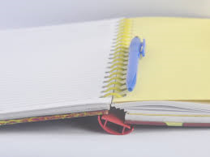
Let`s check the homework
Textbook – page 37/ex.4,5,6,7

Slide 3
Family words
What family words do you know?

Slide 4
New words
wife /waɪf/
husband /ˈhʌzbənd/
cousin /ˈkʌzn/
niece /niːs/
nephew /ˈnefjuː/
stepmother /ˈstepmʌðə(r)/
stepfather /ˈstepfɑːðə(r)/
съпруга
съпруг
братовчед, братовчедка
племенница
племенник
Втора майка
Втори баща

Slide 5
Homework
Textbook – page 39 / ex. 9
Draw your family tree and write a short description of your family.

