Slide 1
Famous monuments
English lesson for the 6th grade

Slide 2
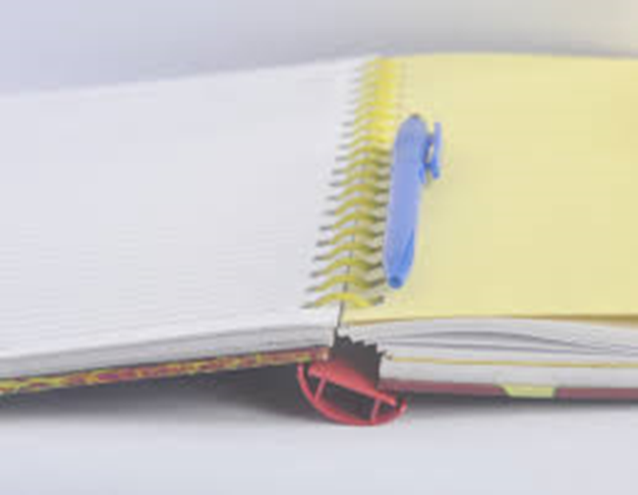
Let`s check the homework
Workbook – page 21
Textbook – page 123/ex.1 and 2
Complete the sentences with adjectives of dimension.

Slide 3
How + adjectives of dimensions
How high?
How tall?
How long?
How wide?
How deep?
How heavy?

Slide 4
Textbook
Pages 34 - 35

Slide 5
New words
monument /ˈmɒnjumənt/
a building that has special historical importance
tower /ˈtaʊə(r)/
a tall narrow building or part of a building, especially of a church or castle
recognize /ˈrekəɡnaɪz/
to know who somebody is or what something is when you see or hear them or it, because you have seen or heard them or it before
date /deɪt/
a particular day or year when a particular event happened
torch /tɔːtʃ/
a long stick that has material at one end that is set on fire and that people carry to give light
паметник на културата
кула
разпознавам
датирам от, водя началото си от
факла

Slide 6
New words
statue /ˈstætʃuː/
a figure of a person or an animal in stone, metal, etc., usually the same size as in real life or larger
harbour /ˈhɑːbə(r)/
an area of water on the coast, protected from the open sea by strong walls, where ships can shelter
статуя
пристанище

Slide 7
Homework
Exercise the new words.

