Slide 1
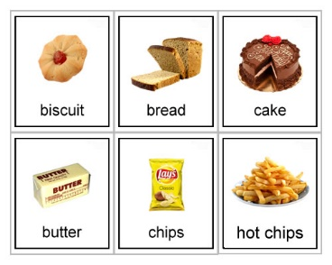
FAST FOOD

Slide 2
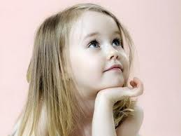
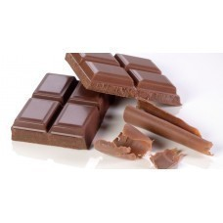
Hello, my name is Lilly.
I`m ten and I`m from London.
I like chocolate. My mum makes the best chocolate cakes.
I love them.
But chocolate isn`t good to eat
a lot.
Now I eat an apple, not chocolate bars for dessert.
My grandpa says: “An apple a day keeps doctor away.’’

Slide 3
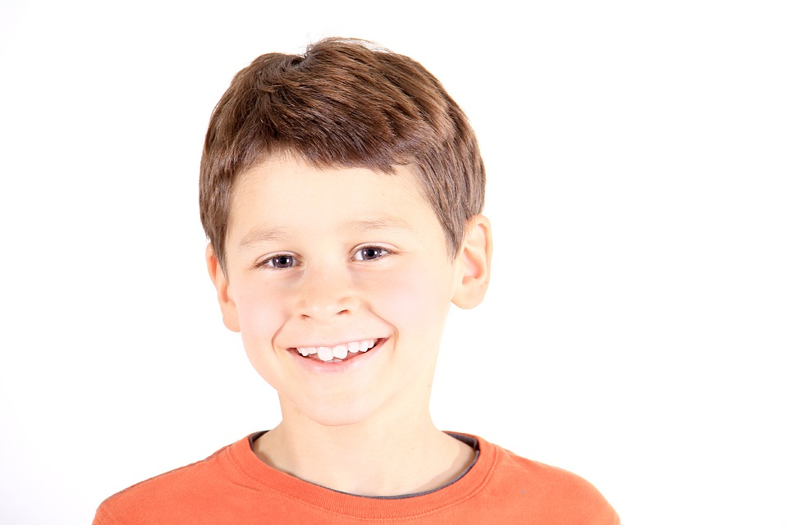
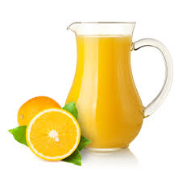
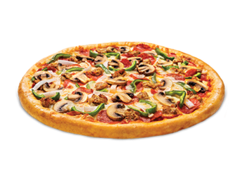
Hello, I`m Tom.
I`m eleven and I`m from Manchester.
I like pizza. I go in an Italian restaurant with my family on Saturdays.
I like cola but it has a lot of sugar in it.
So my mum makes me fresh juice from orange.
Now I drink juice every day and cola only at birthday parties.

Slide 4
True or False
Lilly likes chocolate.
Her mum makes the best milk shakes.
Now Lilly eats apples for dessert.
Lilly is from London.
Tom is from London, too.
He likes pizza.
Tom`s family goes in a restaurant on Mondays.
Tom drinks fresh juice every day.

Slide 5
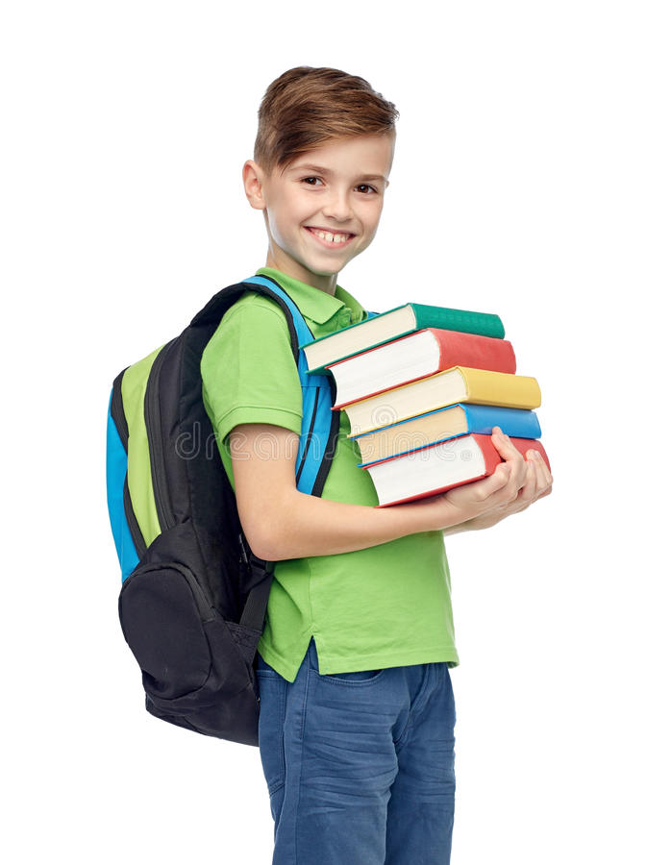
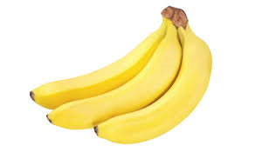
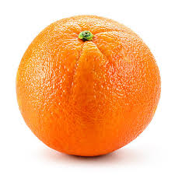
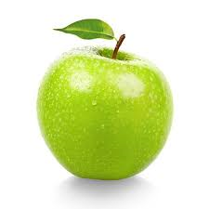
Mark`s bag
What have I got
in my big bag?
A ruler, a pen,
two pencils, three books,
ten crayons. What then?
An apple and an orange
for my lunch
and three bananas
in a bunch.

Slide 6
Homework
Write a healthy menu for breakfast.

