Slide 1
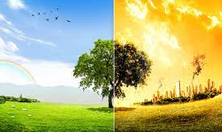
How to help the environment

Slide 2
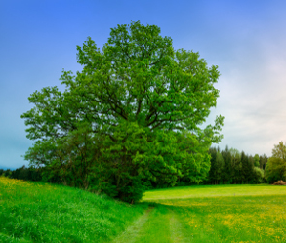
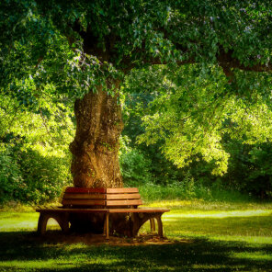
Let’s plant a tree
We have all heard of the belief, because a person is obliged within his life to work on a tree. Let’s think about how many of us and the people around us really did. Trees represent the lungs of our planet. Unfortunately, increasing agricultural land and industrialization is increasing the pace of forest recommendation.

Slide 3
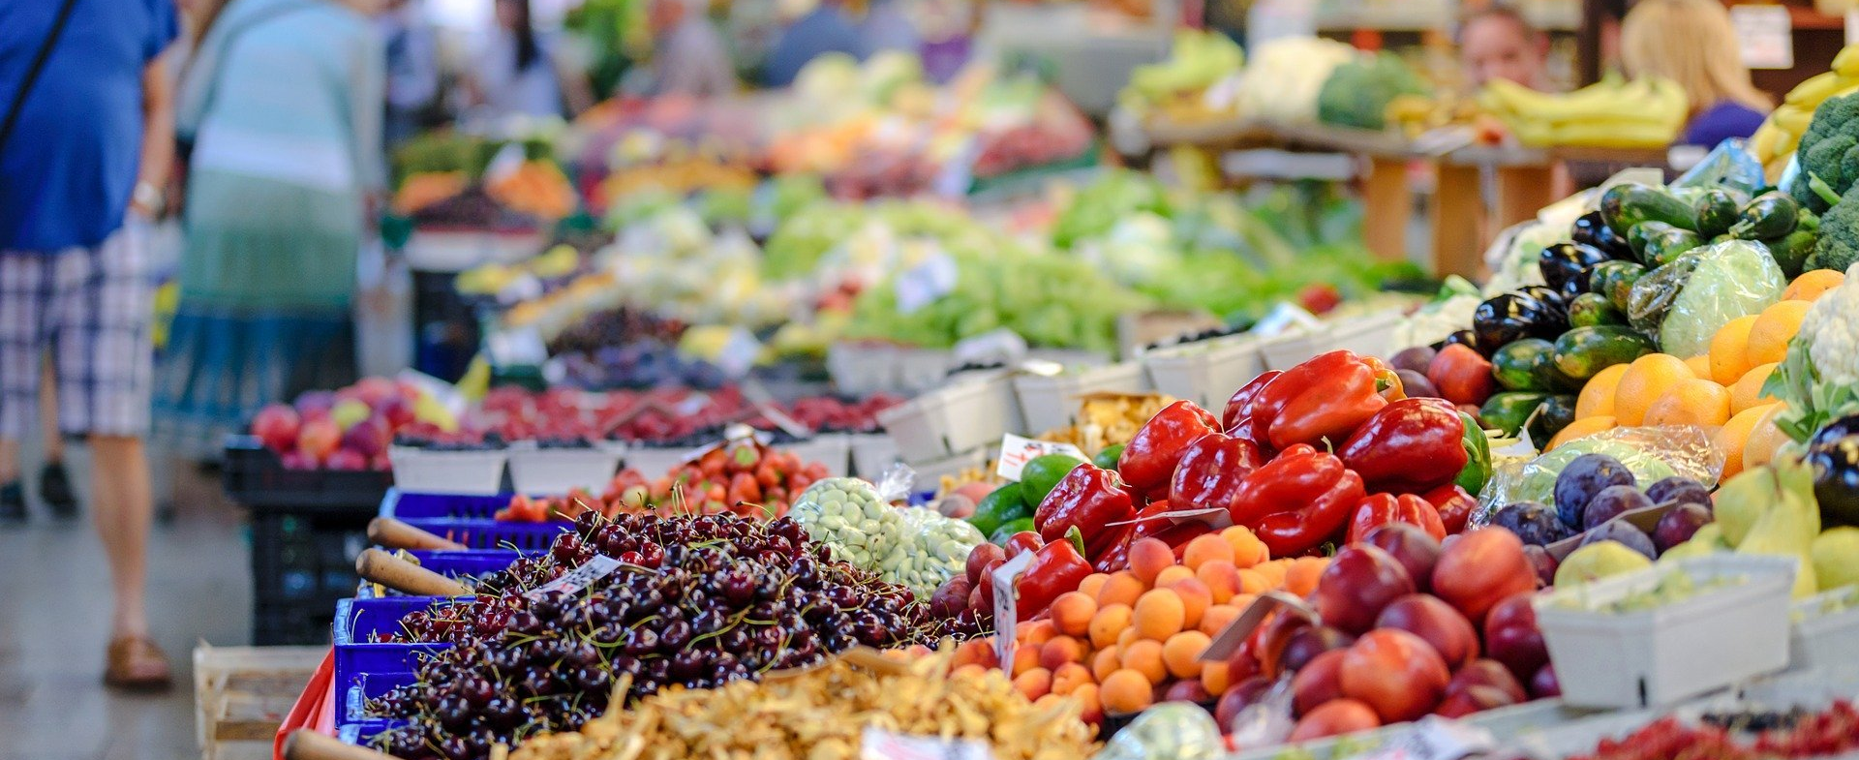
To support local production
The transportation of the food we consume leads to the pollution of nature. One way to keep the environment clean is by buying seasonal fruits and vegetables and those that are produced closer to our home. An even better way to protect nature is to grow our own produce. Some spices and vegetables can be grown in post, so we can’t justify not having a garden.

Slide 4
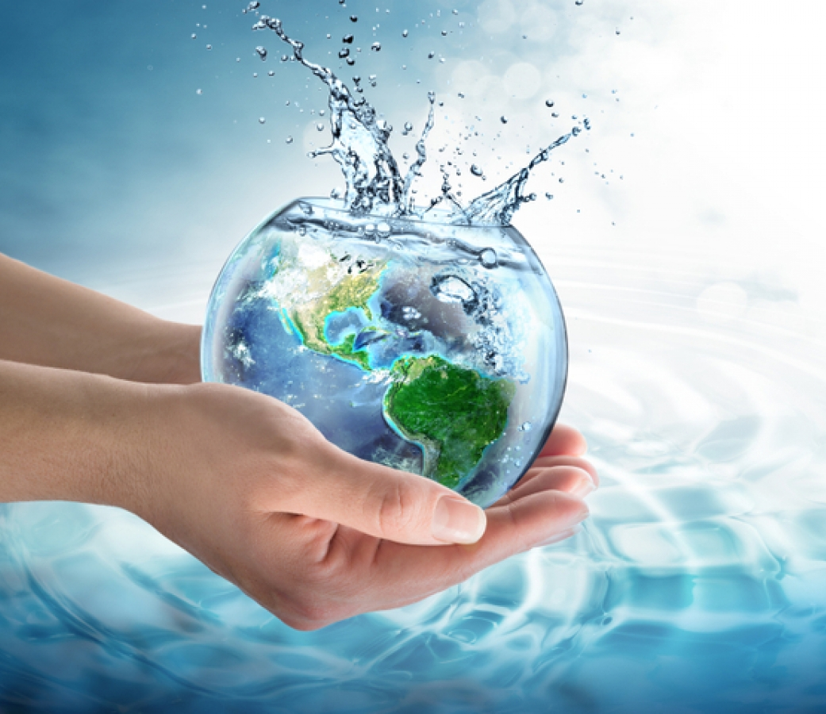
Let’s save water
Sometimes we take water for granted and don’t mix how expensive it is. If you turn off the tap while brushing your teeth, you can save 15-20 liters of water per day. Also, taking a shower instead of a bath does not save twice as much water.

Slide 5
Let’s rethink our mode of transport
One of the main polluters of the environment is harmful emissions from cars. When the weather is good, we can choose the bike or public transport to get to work. Another option, if we still prefer the car, is the shared trip with an acquaintance or colleague.

Slide 6
Let’s think about electricity
If we all start using energy-saving light bulbs, it would be tantamount to removing a million cars from the road. We can use them at least in the bathroom, hallway and closet. Also, if we turn off the computer and other devices at night, we will save electricity without even realizing it.

Slide 7
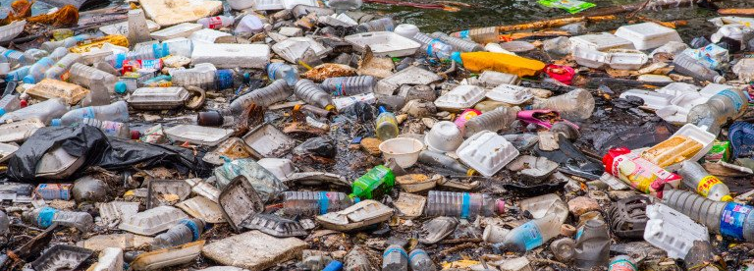
Avoid plastic
Most plastic bottles are not recycled, and it takes thousands of years for them to stay underground and break down. Instead of buying water in plastic bottles, we can use a filter to purify water and thus help nature.

