Slide 1
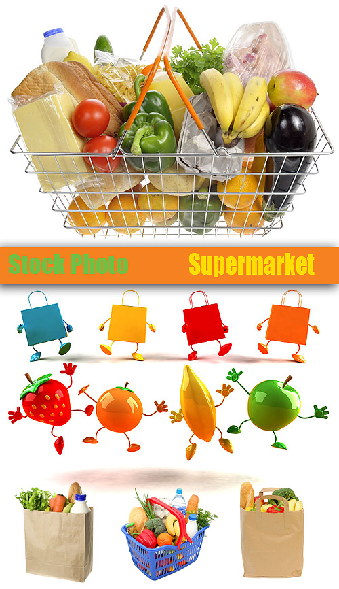
AT THE SUPERMARKET

Slide 2
1. Look at the picture and choose the correct answer.

Slide 3


What’s this?
meat
butter
bread

Slide 4
What’s this?
milk
juice
tea

Slide 5
What’s this?
bowl
jug
egg

Slide 6
What are these?
vegetables
eggs
fruit

Slide 7
What’s this?
sugar
coffee
meat

Slide 8
2. Look at the pictures and
answer to the question.

Slide 9
Is there any milk?
Yes, there are.
Yes, there is.
No, there isn’t.
No, there aren’t.

Slide 10
Are there any bananas?
Yes, there are.
Yes, there is.
No, there isn’t.
No, there aren’t.

Slide 11
Is there any fruit?
Yes, there are.
Yes, there is.
No, there isn’t.
No, there aren’t.

Slide 12
Is there any juice?
Yes, there are.
Yes, there is.
No, there isn’t.
No, there aren’t.

Slide 13
Are there any vegetables?
Yes, there are.
Yes, there is.
No, there isn’t.
No, there aren’t.

Slide 14
Is there any meat?
Yes, there are.
Yes, there is.
No, there isn’t.
No, there aren’t.

Slide 15
Is there any bread?
Yes, there are.
No, there isn’t.
Yes, there is.
No, there aren’t.

Slide 16
3. Complete with the correct word.

Slide 17
There are …….. eggs in the box.
some
any
an

Slide 18
Are there ………... cakes?
any
some
a

Slide 19
There are …… vegetables.
any
some
a

Slide 20
There aren’t ……. cakes.
any
a
some

Slide 21
There’s ……… bread .
a
some
any

Slide 22
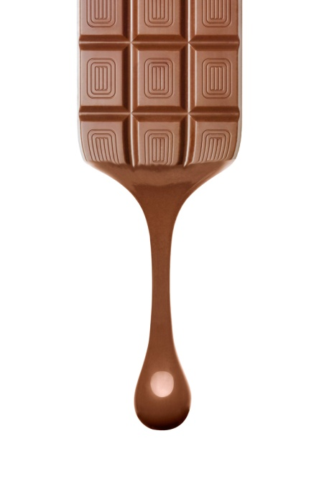
Is there ………... chocolate?
some
any
a

Slide 23
There’s ………. fruit in the basket.
some
any
a

Slide 24
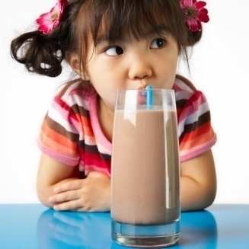
Let’s remember!
(ед. ч.) some / a, an
Some ….
some meat
some milk
some tea
some sugar
some bread
some coffee
some fruit
some water
a / an ….
a bowl
a jug
a dish
an egg
a banana
a cup
a teabag

Slide 25
What is there on the list?
Circle the correct pictures.
coffee
bread
eggs
fruit
milk
juice

Slide 26
Excellent!

