Slide 1
Living and non-living
English lesson for the 3th grade

Slide 2
Living - одушевен
Non-living - неодушевен

Slide 3
Living or non-living
Chair
Ball
Bird
Car
Butterfly
Clock
Non-living
Non-living
Living
Non-living
Living
Non-living

Slide 4
Living or non-living
Book
Fish
Flower
Cat
Sofa
Tree
Ladybird
Non-living
Living
Living
Living
Non-living
Living
Living

Slide 5
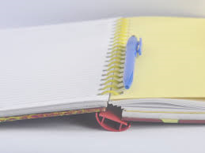
Homework
Workbook – page 29 – ex.1 and 2.

