Slide 1
Music festivals around the world
English lesson for the 6th grade

Slide 2
Complete the sentences. Will or Going to?
Look at the sky. The sun is shining. It ………………… be a hot day.
I think I ………… pass the exam.
is going to
will

Slide 3
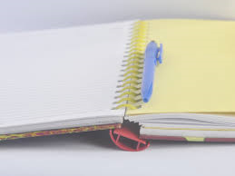
Let`s check the homework.
Read your sentences with will and going to.

Slide 4
Musical instruments
cello

Slide 5
clarinet

Slide 6
double bass

Slide 7
drums

Slide 8
flute

Slide 9
guitar

Slide 10
keyboard

Slide 11
piano

Slide 12
saxophone

Slide 13
trumpet

Slide 14
viola

Slide 15
violin

Slide 16
Do you know any music festival in Bulgaria?
The National Folk Festival of Rozhen

Slide 17
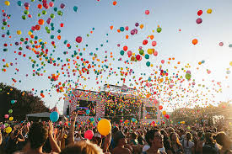
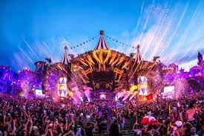
Music festivals around the world
Textbook – pages 94 and 95

Slide 18
Speaking – Tell about you.
Which of the festivals in the photos would you like to go?
Do you ever go to a music festival?
Do you play any musical instrument?
Which instrument would you like to play?

Slide 19
Homework
Textbook – ex.6/p.95
Imagine you are going to organise a youth music festival in your town. Write a paragraph for the school webpage about your plans.

