Slide 1
My house
English lesson for the 3th grade

Slide 2
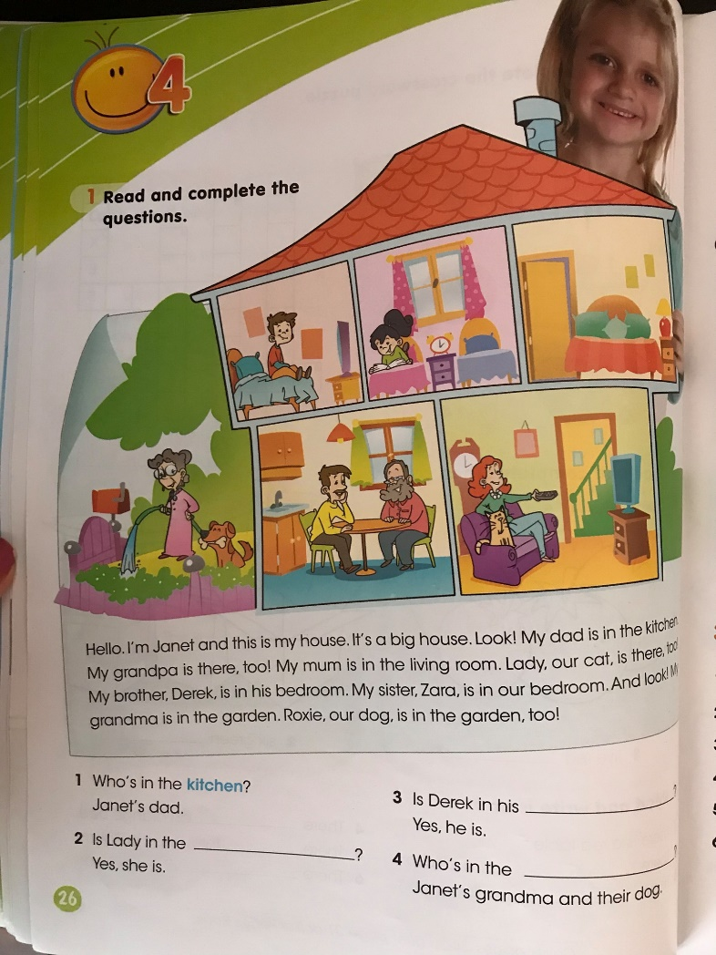
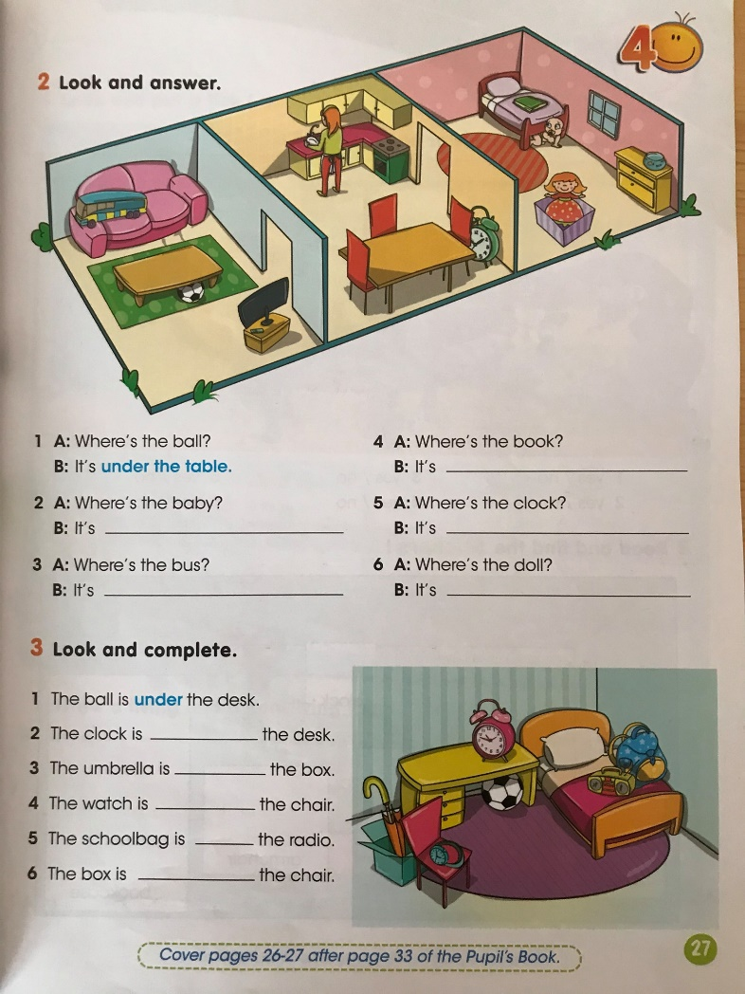
Activity book – pages 26 - 27

Slide 3
Remember!
On - върху
In - във
Under - под
Behind - зад

Slide 4
Parts of the house
b _ _ _ _ _ _ _
b _ _ _ _ _ _
k _ _ _ _ _ _
l _ _ _ _ _ r _ _ _
g _ _ _ _ _
bathroom
bedroom
kitchen
living room
garden

Slide 5
Objects in the rooms
t _ _ _ _
c _ _ _ _
b _ _
s _ _ _
a _ _ _ _ _ _ _
c _ _ _ _
b _ _ _
b _ _ _ _ _ _ _
table
chair
bed
sofa
armchair
clock
bath
bookcase

Slide 6
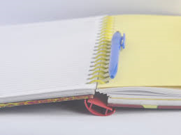
Homework
Project – My house

