Slide 1

Play the Music!
English lesson for the 4th grade

Slide 2
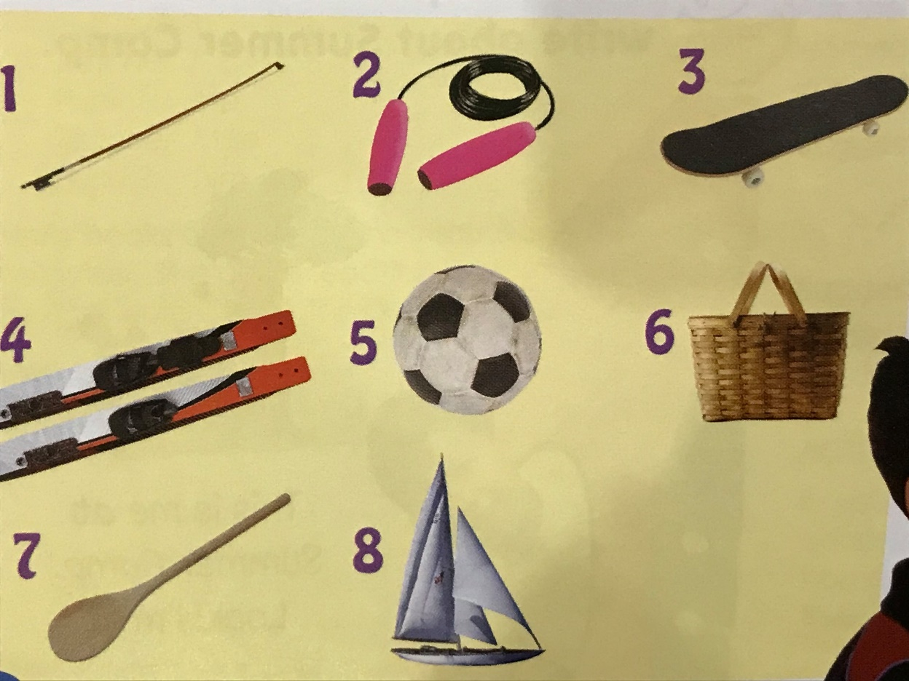
What can you do with this?
Example:
Number 1 – You can play
the violin with it!

Slide 3

piano /piˈænəʊ/

Slide 4
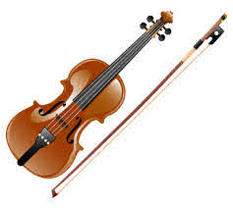
violin /ˌvaɪəˈlɪn/

Slide 5
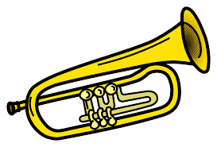
trumpet /ˈtrʌmpɪt/

Slide 6
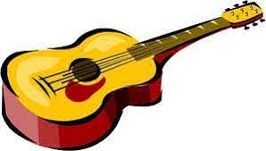
guitar /ɡɪˈtɑː(r)/

Slide 7
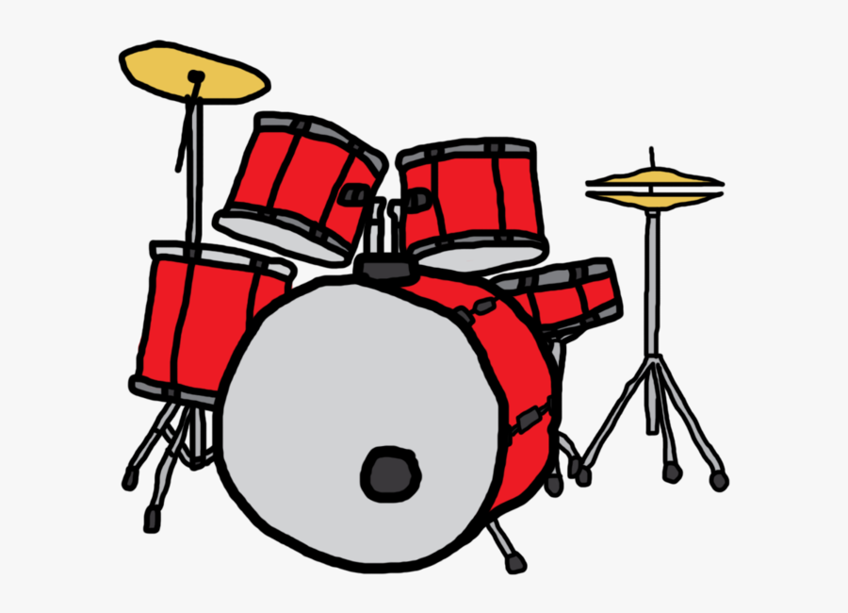
drums /drʌms/

Slide 8
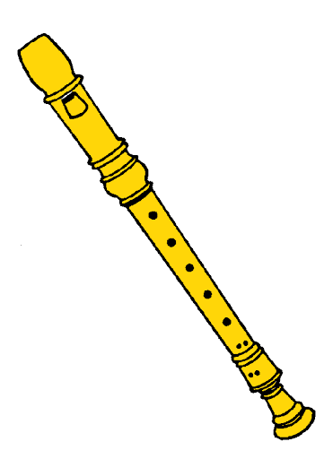
recorder /rɪˈkɔːdə(r)/

Slide 9

tambourine /ˌtæmbəˈriːn/

Slide 10
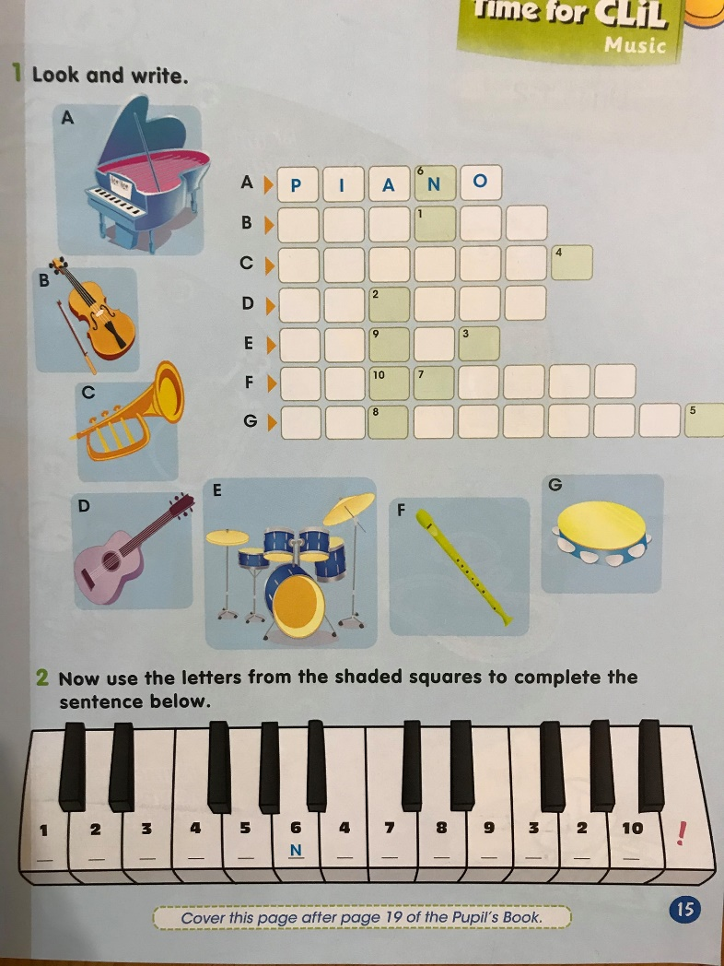
Activity book – page 15

Slide 11
Speaking
What musical instrument do you like playing?

Slide 12
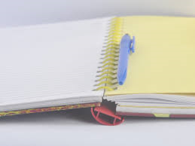
Homework
Exercise the new words!

