Slide 1

The Princess and the pea
English lesson for the 4th grade

Slide 2
Speaking
What fairy tales with princes and princesses do you know?

Slide 3
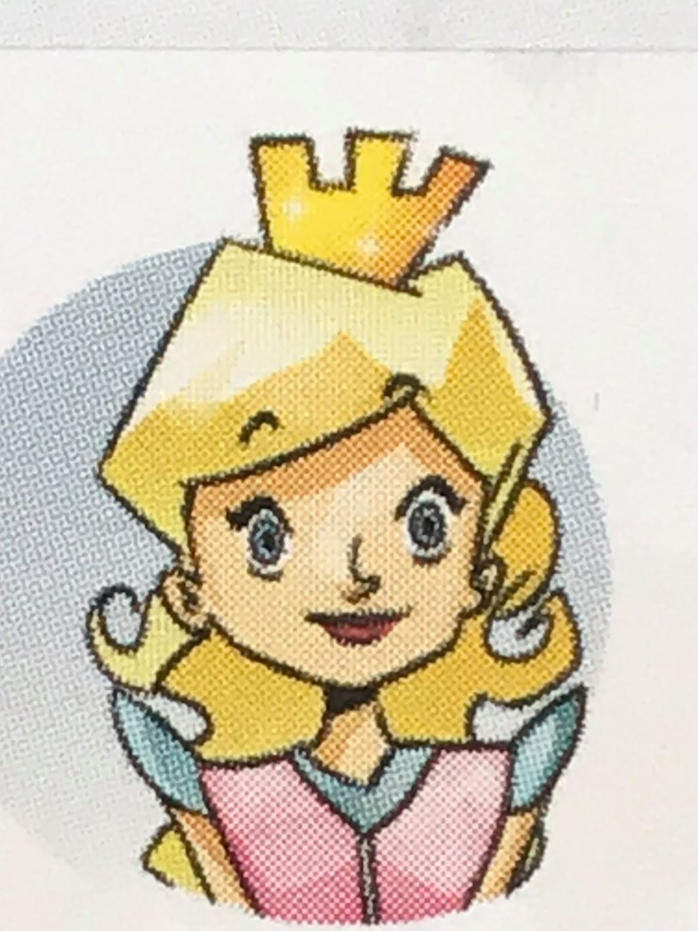
princess /ˈprɪnses/

Slide 4
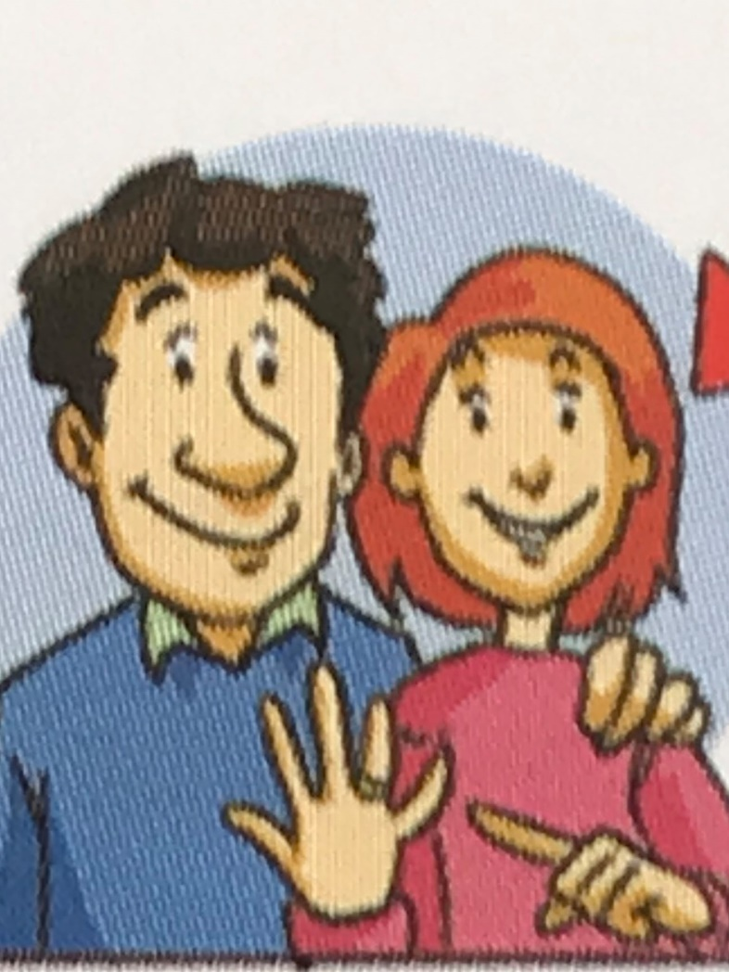
wife /waɪf/

Slide 5
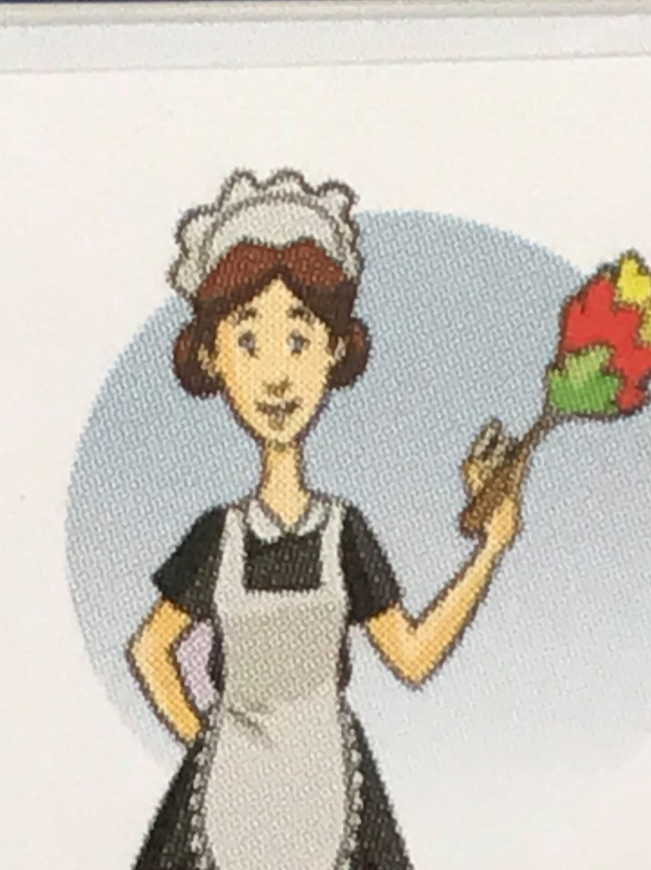
maid /meɪd/

Slide 6
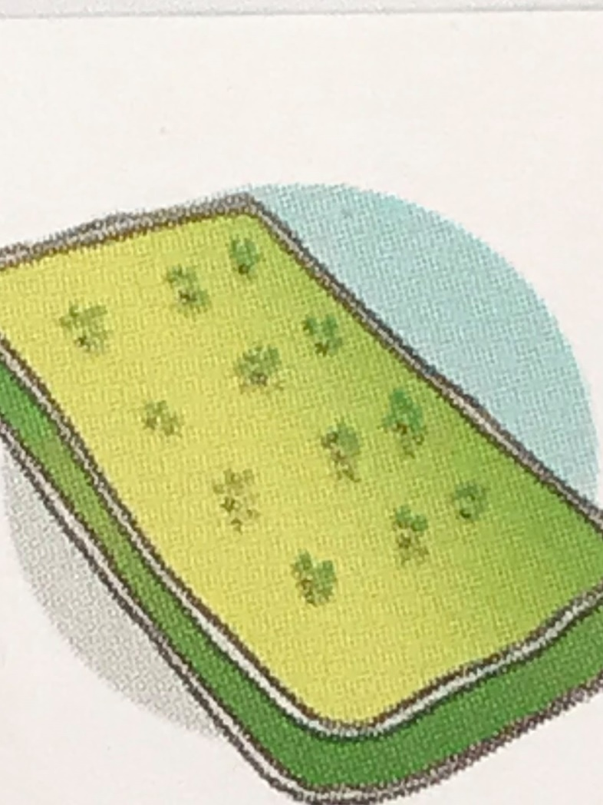
mattress /ˈmætrəs/

Slide 7
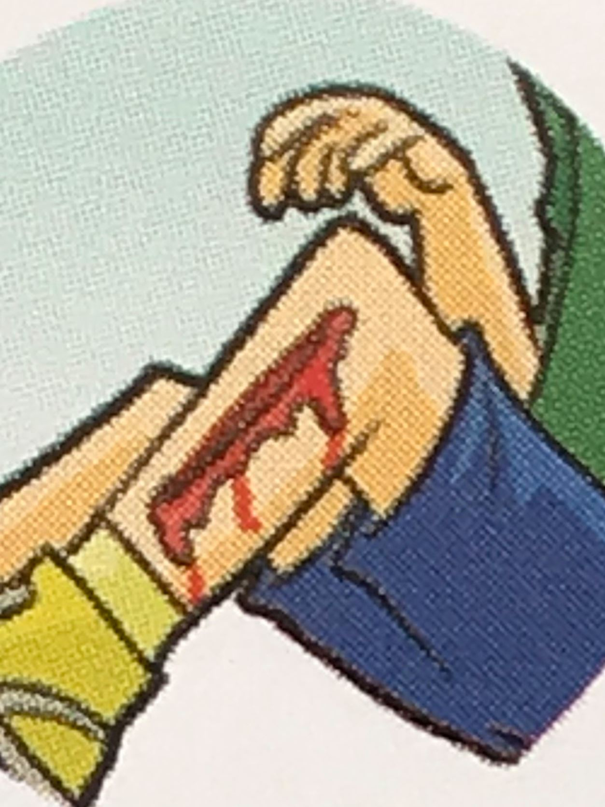
hurt /hɜːt/

Slide 8
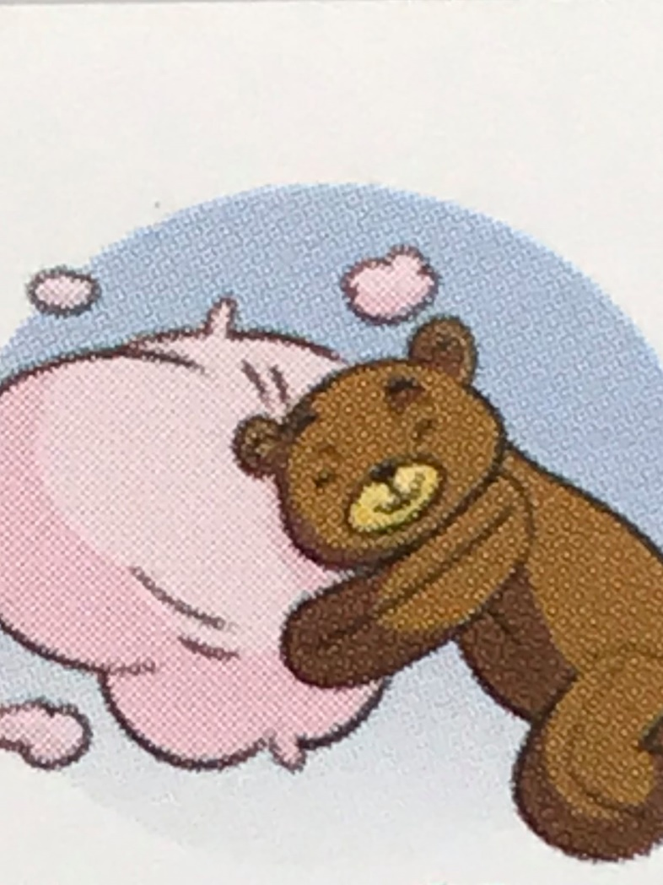
soft /sɒft/

Slide 9
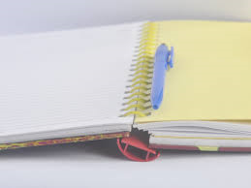
Homework
Exercise the new words!

