Slide 1
What was the date?
English lesson for the 6th grade

Slide 2
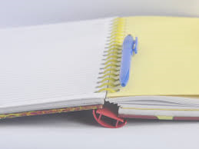
Let`s check the homework
Workbook – page 23

Slide 3
Textbook – What was the date?
Page 38 - 39

Slide 4
Past forms of to be Positive:
I was
You were
He was
She was
It was
We were
You were
They were

Slide 5
Past forms of to be Negative:
I wasn`t
You weren`t
He wasn`t
She wasn`t
It wasn`t
We weren`t
You weren`t
They weren`t

Slide 6
Past forms of to be Question:
Was I ?
Were you?
Was he?
Was she?
Was it?
Were we?
Were you?
Were they?
Short answers:
Yes, I was. / No, I wasn`t.
Yes, you were. / No, you weren`t.
Yes, he was. / No, he wasn`t.

Slide 7
Examples:
I was in the park yesterday.
She wasn`t at school last week.
They visited London two years ago.

Slide 8
Homework
Write ten sentences with the past forms of to be.

