Slide 1
Where is….? Buildings
English lesson for the 4th grade

Slide 2
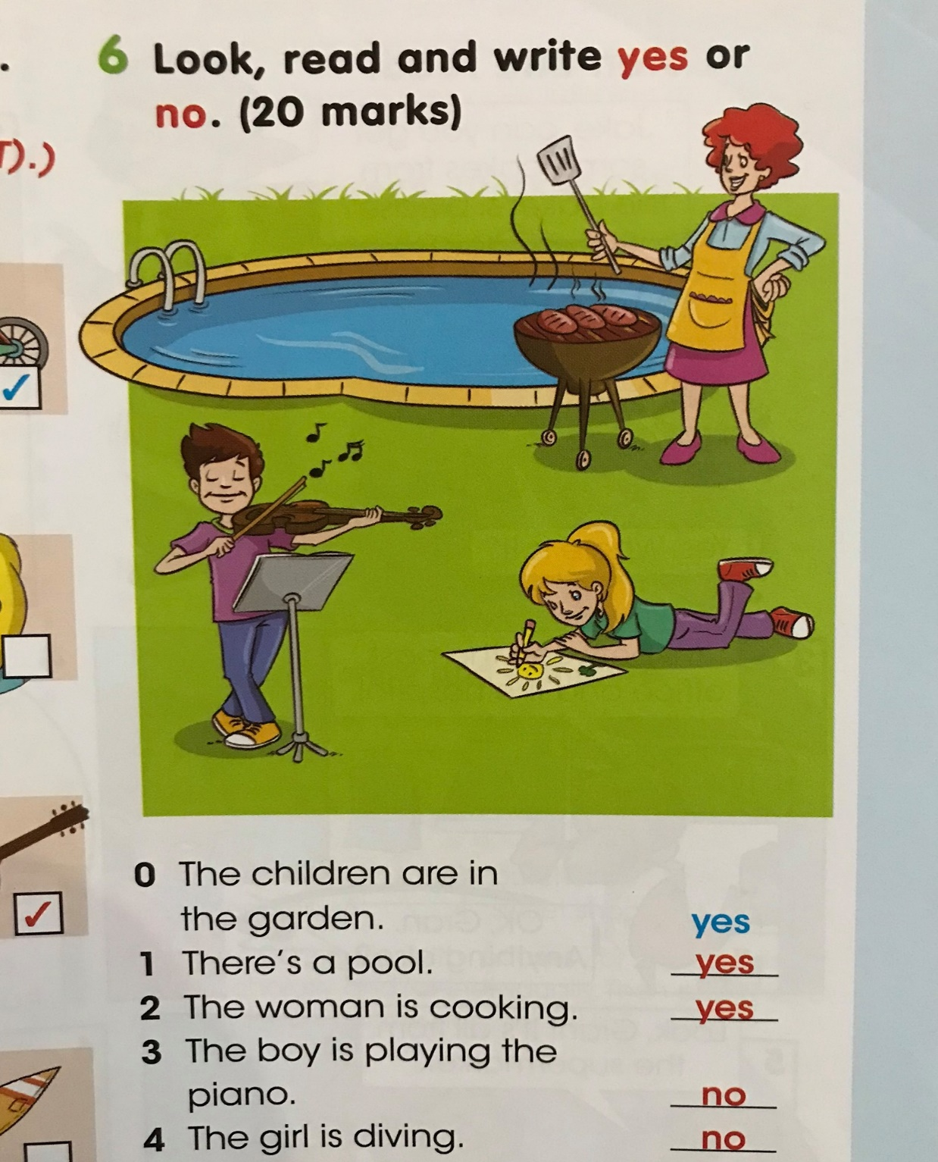

Slide 3
Portfolio
Summer camp

Slide 4
baker`s /ˌbeɪkəz / пекарна

Slide 5
butcher`s /ˈbʊtʃə(r)/ месарница

Slide 6
greengrocer`s /ˈɡriːnɡrəʊsə(r)/
магазин за плодове и зеленчуци

Slide 7
sweet shop /swiːt ʃɒp/ сладкарница

Slide 8
supermarket /ˈsuːpəmɑːkɪt/ супермаркет

Slide 9
bank /bæŋk/ банка

Slide 10
post office /ˈpəʊst ɒfɪs/ поща

Slide 11
hospital /ˈhɒspɪtl/ болница

Slide 12
Homework
Exercise the new words.
Complete ex.2 / p.24 from the textbook.

