Slide 1
My day
English lesson for the 4th grade

Slide 2
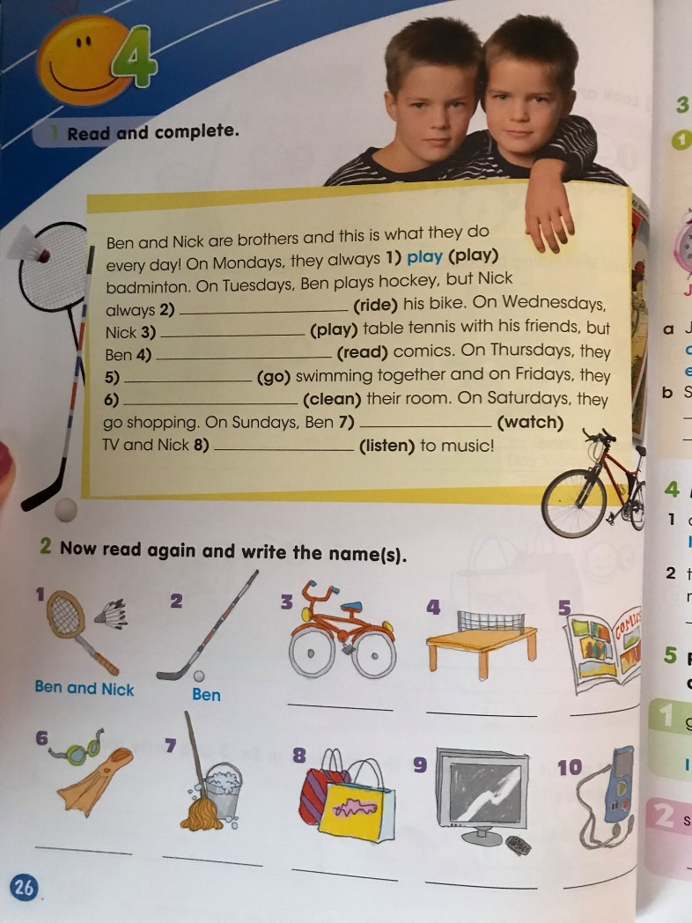
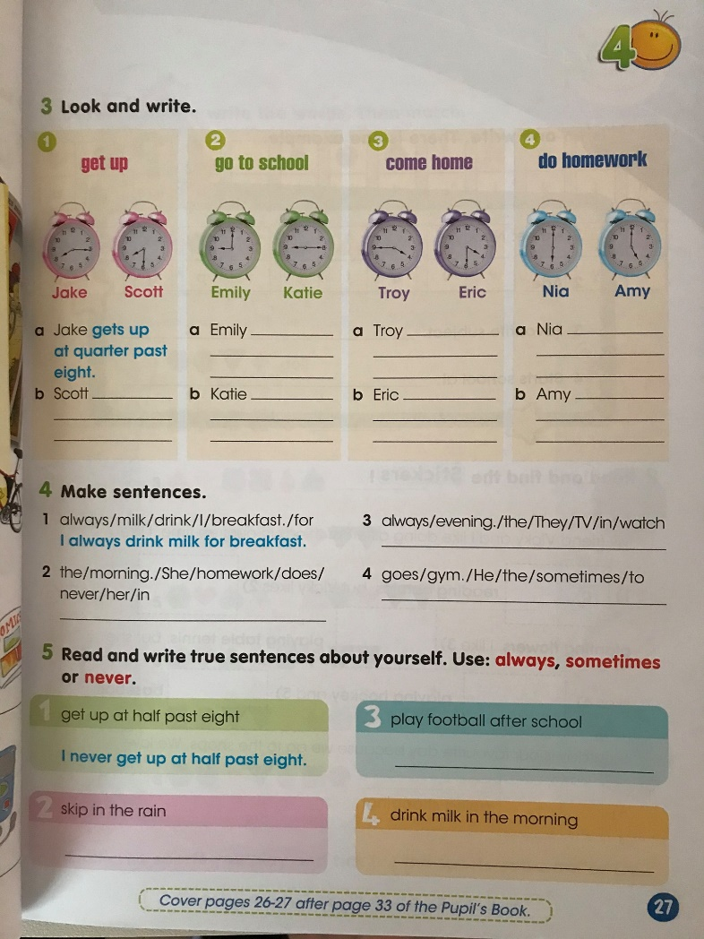
Workbook

Slide 3
How often?
Always - винаги
Sometimes - понякога
Never - никога

Slide 4
Make sentences.
Get up/ I / late / never.
He / school / to / at 7 o`clock / goes.
Emma / does / school / start / at 8 o`clock?
Play / Tom and Peter / badminton / sometimes.
Do / read / you / sometimes / comics?
We / our room / clean / always.
I never get up late.
He goes to school at 7 o`clock.
Does Emma start school at 8 o`clock?
Tom and Peter sometimes play badminton.
Do you sometimes read comics?
We always clean our room.

Slide 5
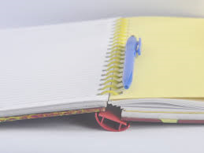
Homework
A project
“My day’’

